Slide 1
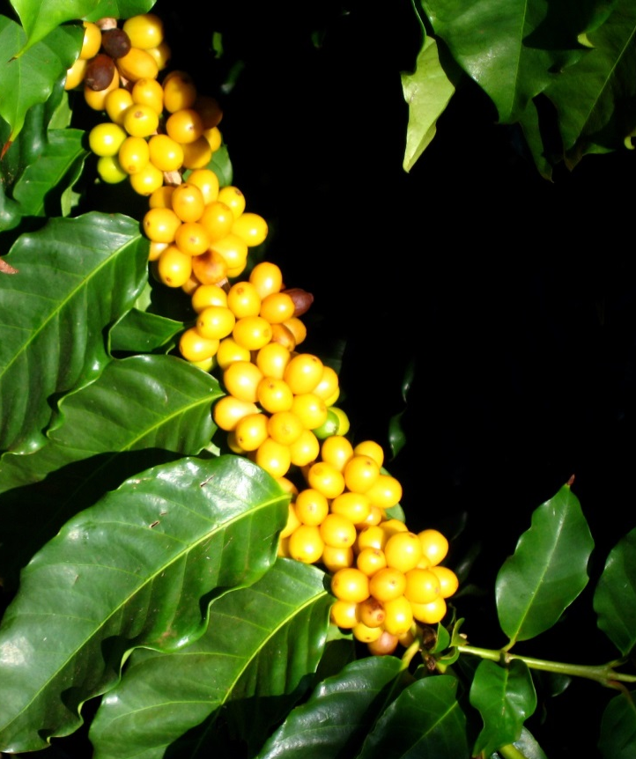
Hawaii Coffee Growers Report
Kimo Falconer
MauiGrown Coffee Distributors
&
Assistance from the
Hawaii Coffee Growers Association and Industry
July 21, 2017

Slide 2
Outline
USDA Hawaii Coffee Marketings
Kauai
Oahu
Maui
Hawaii Island

Slide 4
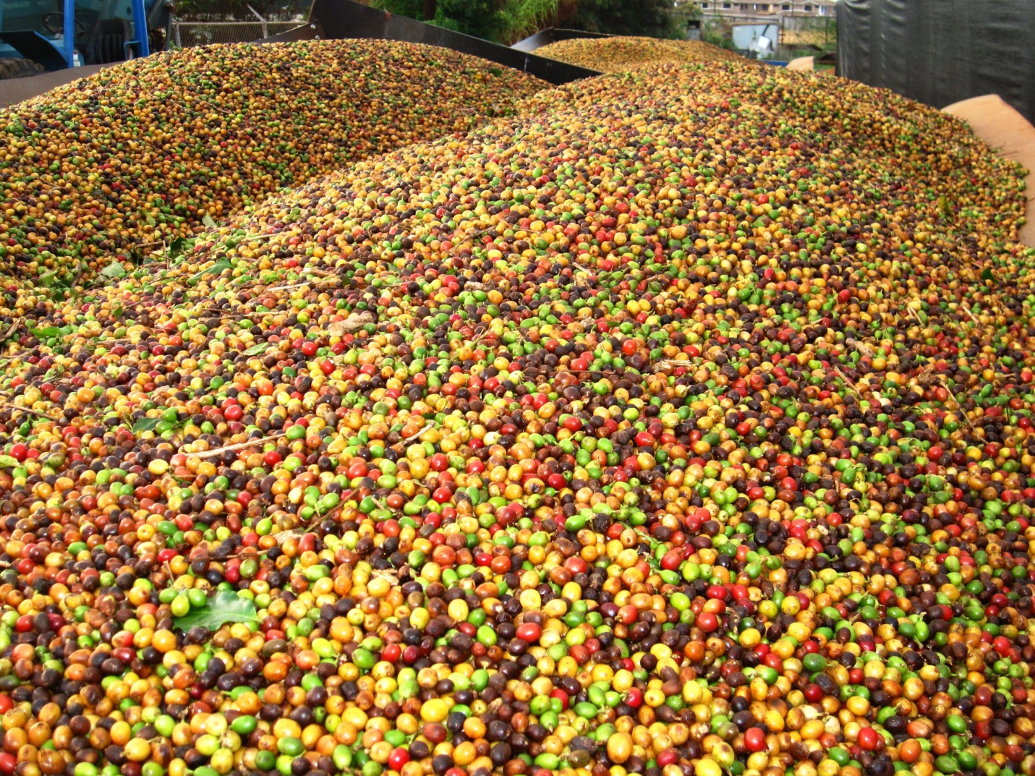
Kauai
3 commercial coffee farms
Kauai Coffee Company
Moloa‘a Bay Coffee
Blair Estate Coffee
No CBB reported

Slide 5
Kauai
2016 – 2017 Yield/Acreage
2,515 acres
10 million lbs. cherry
2.3 million lbs. green bean (23% recovery)
Crop Comments:
Pumping station fire affected irrigation second half of growing cycle
50 – 60% water deficit thru summer = reduced yield
Kauai Coffee Company

Slide 6
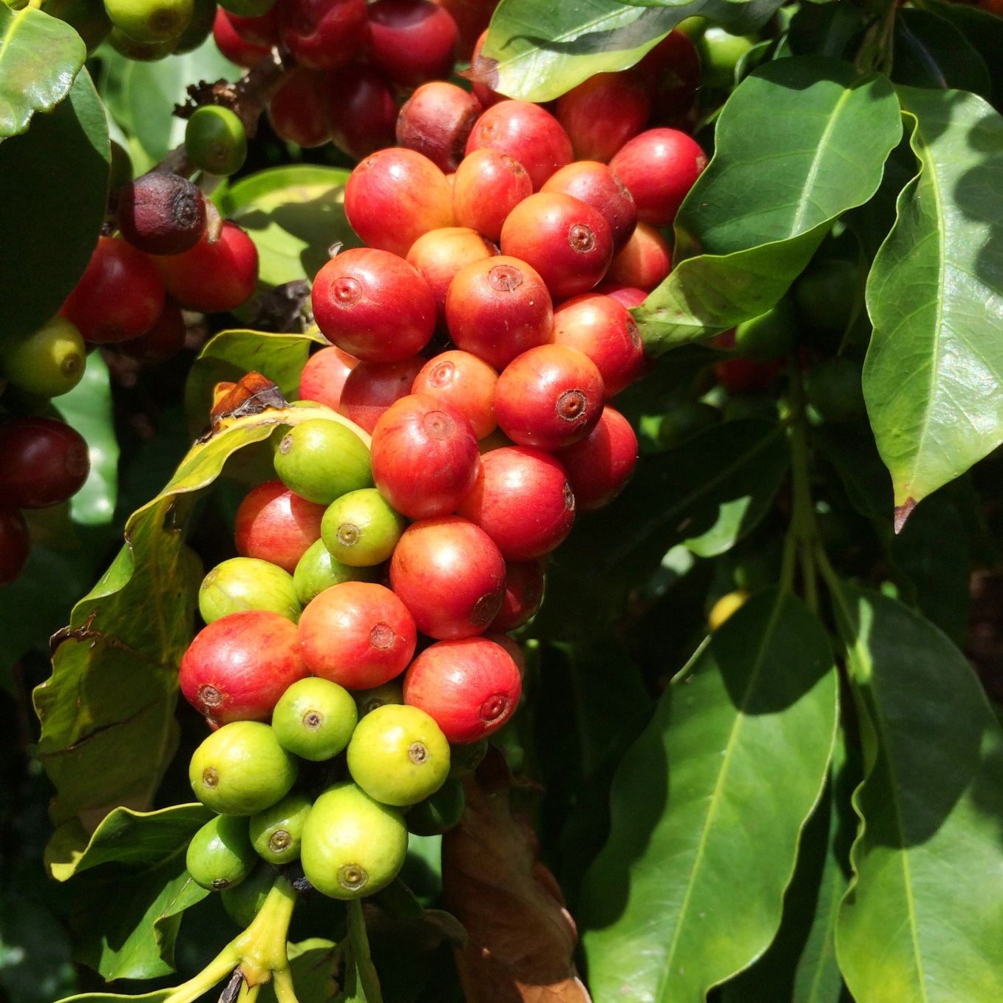
Kauai
2017 - 2018 season - Outlook
2,690 harvest acres
2.9 million lbs. of green bean
13 million lbs. cherry
Pump station fully operational now
Dry 2017 spring and reduced pumping will affect crop size
CBB trapping checked weekly by staff and UH teams
Kauai Coffee Company

Slide 7
Kauai
2016 – 2017 Yield/Acreage
6 acres Typica variety
10,000 lbs. cherry
Diversifying into other crops (Cacao)
2016 – 2017 - Outlook
20,000 lbs. cherry, improvements to irrigation and fertigation
New Hoshidana drying deck for parchment
Moloa’a Coffee Company

Slide 8
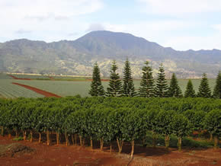
Oahu
Waialua Estate Coffee
HARC (Kunia & Maunawili)

Slide 9
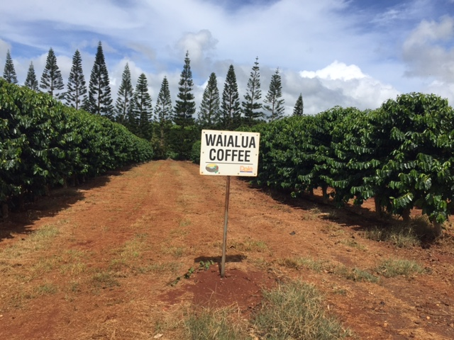
Oahu
2016 – 2017 Yield/Acreage
155 acres Typica variety
423,000 lbs. cherry
<100,000 lbs. green bean for island
25% acreage stump pruning
65% natural, 35% washed
Est. CBB damage 15%
Managed by Mike Conway,
Kyle Barber & Michelle Yamaguchi
Waialua Estate Coffee

Slide 10
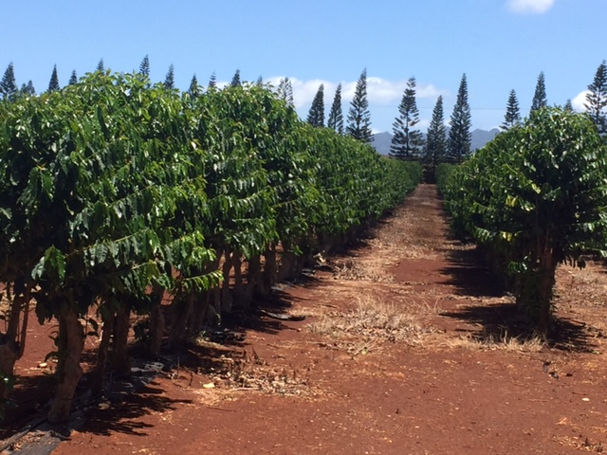
Oahu
Waialua Estate Coffee cont.
2017 – 2018 Outlook
Producing acreage decreased from 275 to 115 acres
Yield expected to be 225,000 lbs cherry
2017 dryer weather favors good harvest & recovery
Low incidence of mold in Naturals, excellent recovery
2017 good flowering, expect approx. 35% yield/acre increase

Slide 11
Oahu
Increase monitoring of CBB traps and surveys
Monthly sprays of Botanigard and Pyganic (starts 30 days after flowering)
400 gallon Gearmore canon mister, effective in dense canopies
Biggest unresolved challenge is removing remaining raisins from trees
Raisin on the ground shows less CBB infestation than those left on trees
Using the SHAC and HDOA subsidy program or Botanigard
Waialua Estate Coffee cont.

Slide 12
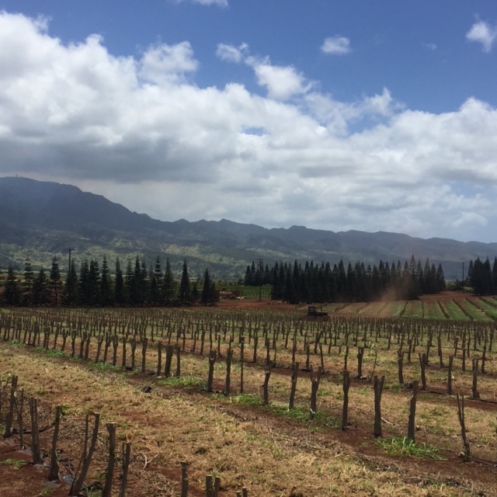
2017 final year of stump-cut program
Oahu
Waialua Estate Coffee cont.

Slide 13
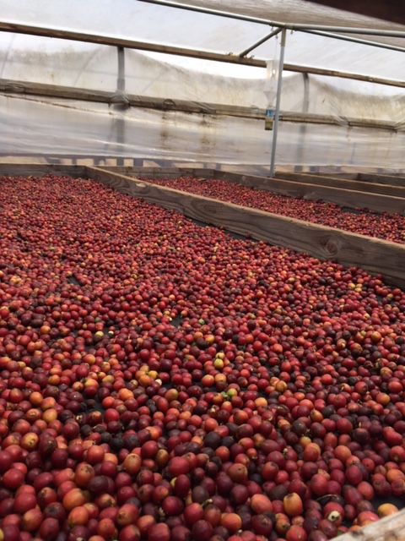
Oahu
Waialua Estate Coffee cont.

Slide 14
Oahu
HARC (Kunia & Maunawili)
5-10 acres non productive
CBB found at Kunia in 2016
Confirmed finding in Maunawili in August 2016, also on the Waianae Coast
HARC

Slide 15
Maui
MauiGrown Coffee
Maui Coffee Association

Slide 16
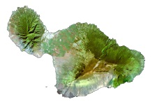
Maui
2016 – 2017 Yield/Acreage
315 harvest acres
2,000,000 lbs. cherry
400,000 lbs. green bean
MauiGrown Coffee

Slide 17
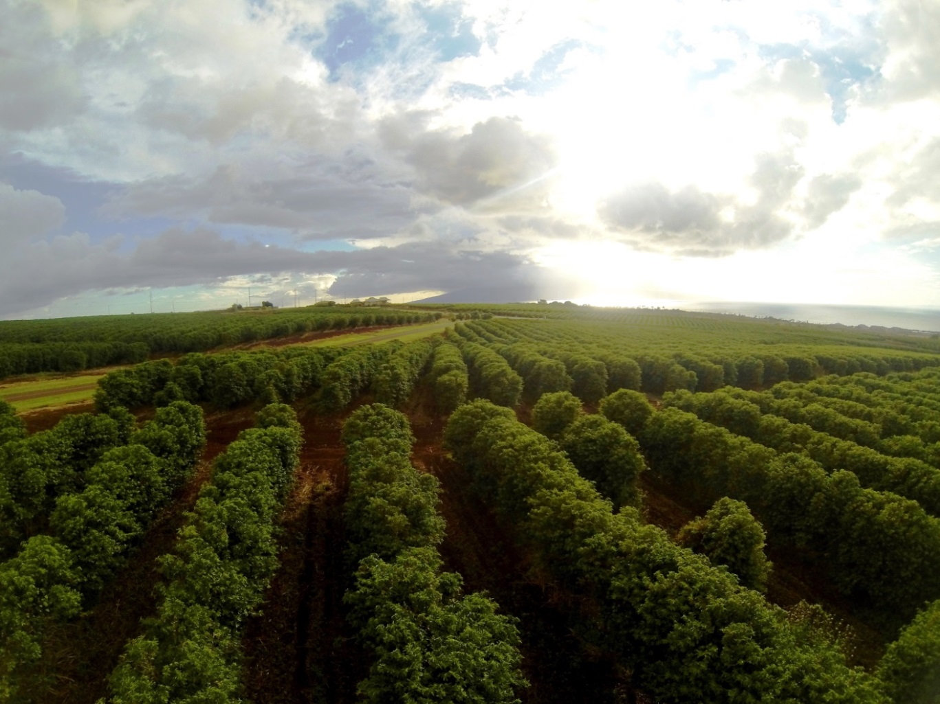
Maui
MauiGrown Coffee
2017 – 2018 - Outlook
WET early season, flowering inconsistent.
Good growing conditions overall
Acreage expansion ongoing
Yield expected to be 2,000,000 lbs cherry
No CBB found on farm

Slide 18
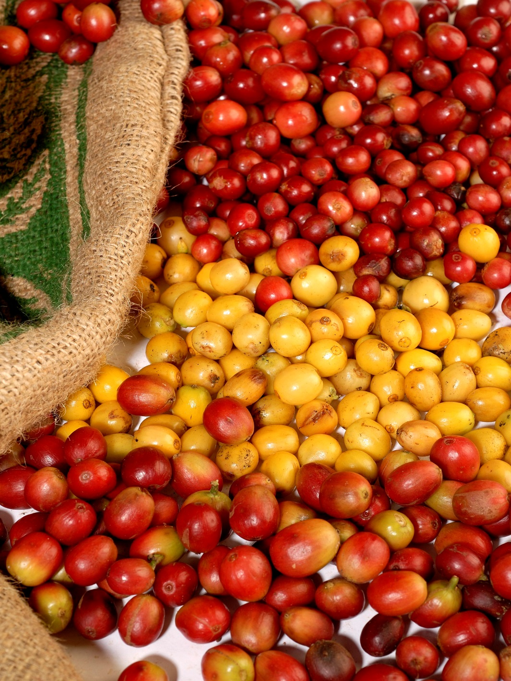
Maui
MauiGrown Coffee

Slide 19
Maui
Maui Coffee Association (Upcountry and other regions of Maui)
20 farms reporting in, acreage unknown (est. 100 acres cumulative)
Approx. 20,000 lbs cherry moderate increase
All sold roasted/~1% sold as green bean
Yields affected due to heavy rains(+235% normal)
CBB found in Hana 2016, on 6/28/17 CBB reported in Ulupalakua
Maui Coffee Association

Slide 20
Maui

Slide 21
Hawaii Island

Slide 22
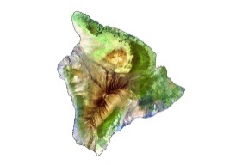
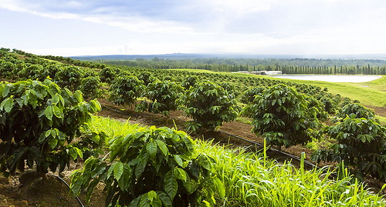
Hawaii Island
2016 – 2017 Yield/Acreage
500 harvest acres
4.8 million lbs. cherry
351,750 lbs. green bean
Ka’u

Slide 23
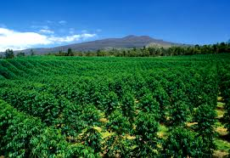
Hawaii Island
2017 – 2018 - Outlook
Coffee market continues to grow in Ka’u
Increased education among workers leading to better yields and consistent quality
Looking at an early harvest season
Immigration policy and labor law compliance will cause difficult harvest season
20% target loss of crop due to labor shortage
Unharvested cherries will exacerbate the CBB problem
Black Twig Borer is present.
Ka’u

Slide 24
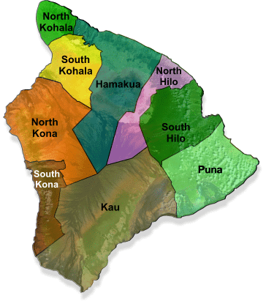
Hawaii Island
No production figures available
Kohala & Hamakua
~15 farms
~45 acres
Hilo
~4 farms
~10 acres
Puna
~20 farms
~70 acres
Hawaii Island (cont.)

Slide 25
Hawaii Island
2016 - 2017
Rain was relatively consistent throughout the year which resulted in a late bloom
Late bloom this season was biggest most concentrated bloom in history
There was a shortage of labor for the concentrated harvest season
The average CBB content in the cherry greatly reduced this season
Estimated 2.4 million lbs. green bean/approx. - 900 farms
Kona

Slide 26
Hawaii Island
2017 – 2018 - Outlook
Due to a significant bloom in December the crop will not likely be difficult to harvest this season
Harvest season will begin to develop in late September into mid-December
Focused on utilizing foreign labors with legal entry in U.S.
Increased cost in legal foreign labor
HCA will continue to work with USDA Foreign Ag Service on MRL’s for PBO in Japan
Kona

Slide 27
Overview: Hawaii Coffee Industry
2017 - 2018 coffee season looks promising state-wide
Coffee industry is continuing to grow in spite of CBB spreading
CBB currently contained to Hawaii Island, Maui and Oahu
More farmers are adopting CBB management practices and reducing bean damages
Must remain vigilant of the spread of CBB to neighbor islands
Must be aware of pathways to introducing coffee leaf rust, coffee berry disease and other pests and diseases not yet found in Hawaii that could devastate the industry
No longer the only state producing commercial coffee

Slide 28
Steps to Reducing Potential Threats
If traveling:
Leave clothing, footwear, hat, and other supplies in the country when exposed or potentially exposed to pests and diseases not found in HI.
Shower and wash clothing or other materials potentially exposed to rust, etc. prior to arrival in Hawaii.
Heat clothing and other materials to 165°F for 3 minutes or more to kill rust spores.
http://eskipaper.com/images/free-aviation-wallpaper-1.jpg

Slide 29
Do not transport coffee plants, seeds, leaves, soil, used farm or mill supplies, etc. to Hawaii.
Steps to Reducing Potential Threats (cont.)

Slide 30
Mahalo!

